Slide 1
E1-277 Reinforcement Learning Safe RL in Constrained MDPs
Pratik Likhar – 16575
Akhilesh Yadav - 17410
Abhishek Ranjan – 18390

Slide 2
Contents
Introduction
Problem Statement
Background
Algorithm
Theoretical Results
Experiments and Conclusion
Applications

Slide 3
Introduction
The objective of safe RL is to maximize the cumulative reward while guaranteeing or encouraging safety.
Authors have proposed a safe near-optimal MDP, SNO-MDP algorithm, for achieving a near-optimal cumulative reward while guaranteeing safety in a constrained MDP

Slide 4
The safety and efficiency of SNO-MDP are then evaluated with GPSAFETY-GYM synthetic environment.
In earlier work in this field, Safe space was provided to the model and agent has to maximize the reward given that safe space. But here we are exploring the state space to expand the safe space and then agent acts on that new safe space to maximize the cumulative reward.

Slide 5
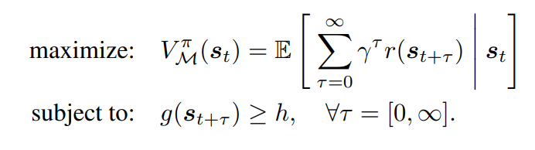
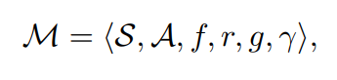
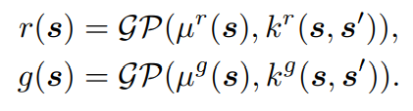
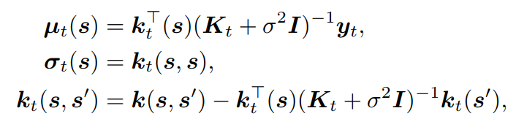
PROBLEM STATEMENT

Slide 6
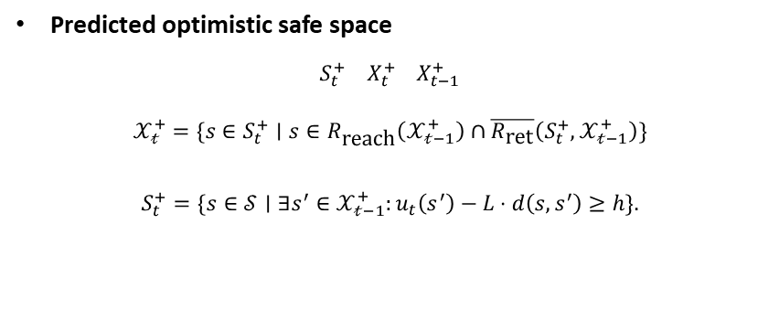
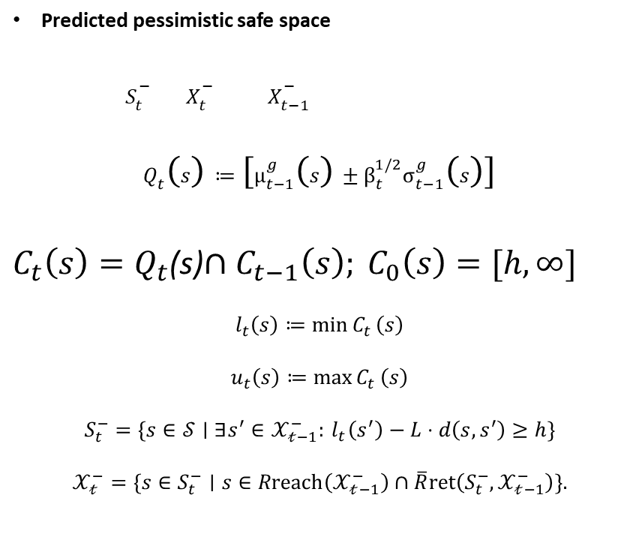
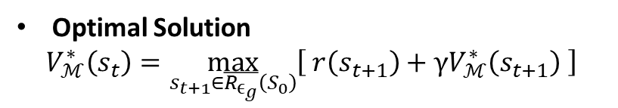
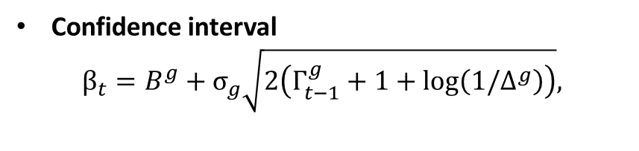
BACKGROUND
Predicted pessimistic safe space
$S_{t}^{−} X_{t}^{−} X_{t−1}^{−}$
$$Q_{t}\left(s\right)≔\left[μ_{t−1}^{g}\left(s\right)±β_{t}^{1/2}σ_{t−1}^{g}\left(s\right)\right]$$
$C_{t}\left(s\right)=Q_{t}$(s)$∩C_{t−1}\left(s\right); C_{0}\left(s\right)=[h,∞]$
$$l_{t}\left(s\right)≔\min{C_{t}}\left(s\right)$$
$$u_{t}\left(s\right)≔\max{C_{t}}\left(s\right)$$
$$S_{t}^{−}=\{s∈𝒮∣∃s^{′}∈𝒳_{𝓉−1}^{−}:{ l}_{t}\left(s^{′}\right)−L⋅d\left(s,s^{′}\right)≥h\}$$
$$𝒳_{𝓉}^{−}=\{s∈S_{t}^{−}∣s∈R\text{reach}\left(𝒳_{𝓉−1}^{−}\right)∩\overline{R}\text{ret}\left(S_{t}^{−},𝒳_{𝓉−1}^{−}\right)\}.$$
Predicted optimistic safe space
$$S_{t}^{+} X_{t}^{+} X_{t−1}^{+}$$
$$𝒳_{𝓉}^{+}=\{s∈S_{t}^{+}∣s∈R_{\text{reach}}\left(𝒳_{𝓉−1}^{+}\right)∩\overline{R_{\text{ret}}}\left(S_{t}^{+},𝒳_{𝓉−1}^{+}\right)\}$$
$$S_{t}^{+}=\{s∈𝒮∣∃s^{′}∈𝒳_{𝓉−1}^{+}:u_{t}\left(s^{′}\right)−L⋅d\left(s,s^{′}\right)≥h\}.$$
Confidence interval
$$β_{t}=B^{g}+σ_{g}\sqrt{2\left(Γ_{t−1}^{g}+1+\log\left(1/Δ^{g}\right)\right)},$$
Optimal Solution
$$V_{ℳ}^{∗}\left(s_{t}\right)=\max_{s_{t+1}∈\overline{R_{ϵ_{g}}}\left(S_{0}\right)}\left[ r\left(s_{t+1}\right)+γV_{ℳ}^{∗}\left(s_{t+1}\right) \right]$$

Slide 7
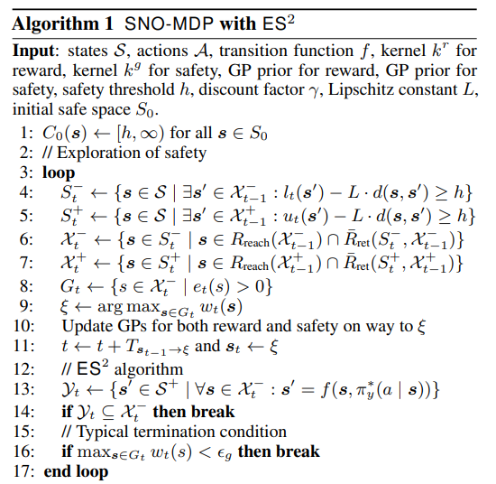
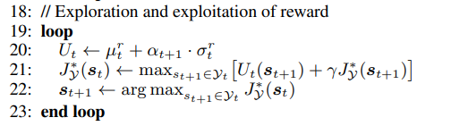
Algorithm

Slide 8
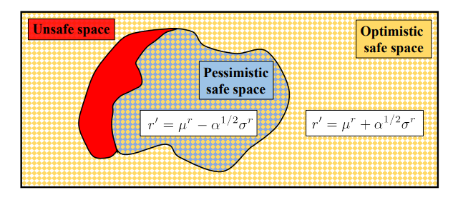
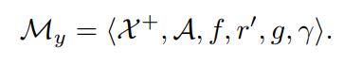
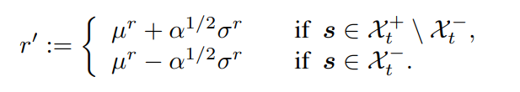
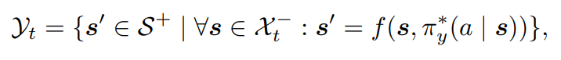
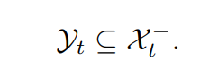
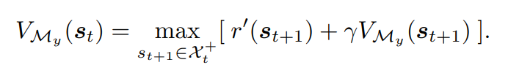

Slide 9
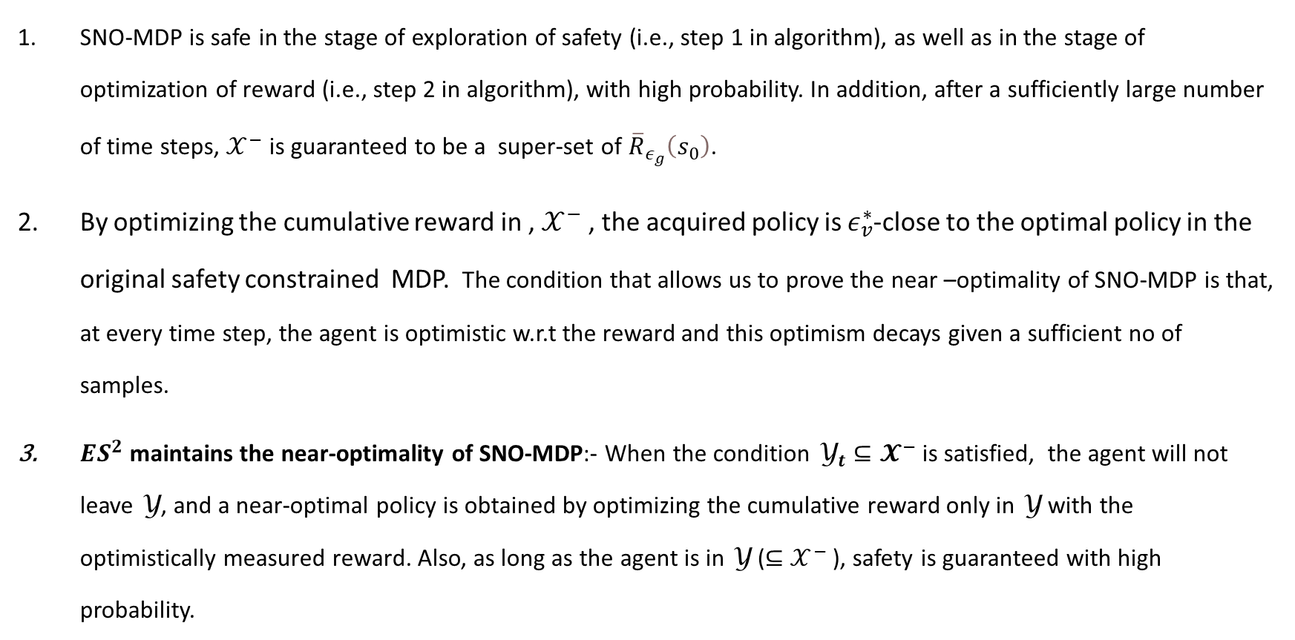
Theoretical Result
SNO-MDP is safe in the stage of exploration of safety (i.e., step 1 in algorithm), as well as in the stage of optimization of reward (i.e., step 2 in algorithm), with high probability. In addition, after a sufficiently large number of time steps, $𝒳^{−}$ is guaranteed to be a super-set of ${\overline{R}}_{ε_{g}}\left(s_{0}\right)$.
By optimizing the cumulative reward in , $𝒳^{−}$ , the acquired policy is $ε_{v}^{∗}$-close to the optimal policy in the original safety constrained MDP. The condition that allows us to prove the near –optimality of SNO-MDP is that, at every time step, the agent is optimistic w.r.t the reward and this optimism decays given a sufficient no of samples.
$ES^{2}$ maintains the near-optimality of SNO-MDP:- When the condition ${\text{Y}}_{t}⊆𝓧^{−}$ is satisfied, the agent will not leave Y, and a near-optimal policy is obtained by optimizing the cumulative reward only in Y with the optimistically measured reward. Also, as long as the agent is in Y (⊆ $𝒳^{−}$ ), safety is guaranteed with high probability.

Slide 10
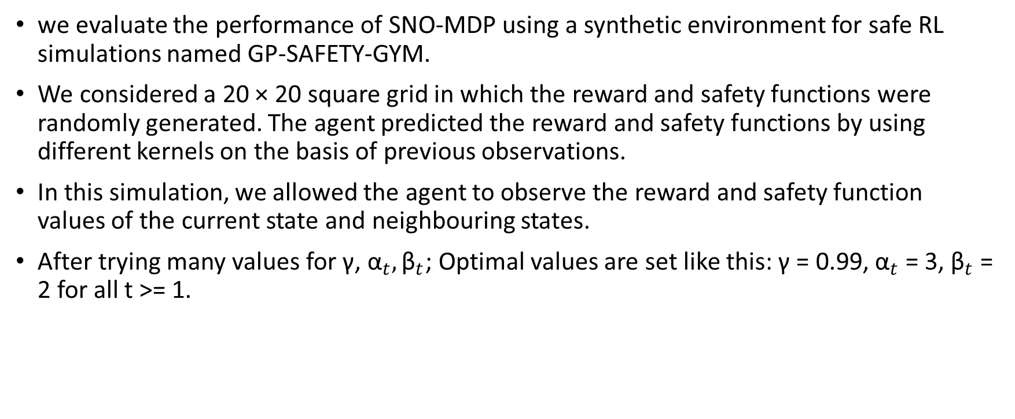
Experiment and Results
we evaluate the performance of SNO-MDP using a synthetic environment for safe RL simulations named GP-SAFETY-GYM.
We considered a 20 × 20 square grid in which the reward and safety functions were randomly generated. The agent predicted the reward and safety functions by using different kernels on the basis of previous observations.
In this simulation, we allowed the agent to observe the reward and safety function values of the current state and neighbouring states.
After trying many values for γ, ${\text{α}}_{t}, {\text{β}}_{t}$; Optimal values are set like this: γ = 0.99, ${\text{α}}_{t}$ = 3, ${\text{β}}_{t}$ = 2 for all t >= 1.

Slide 11
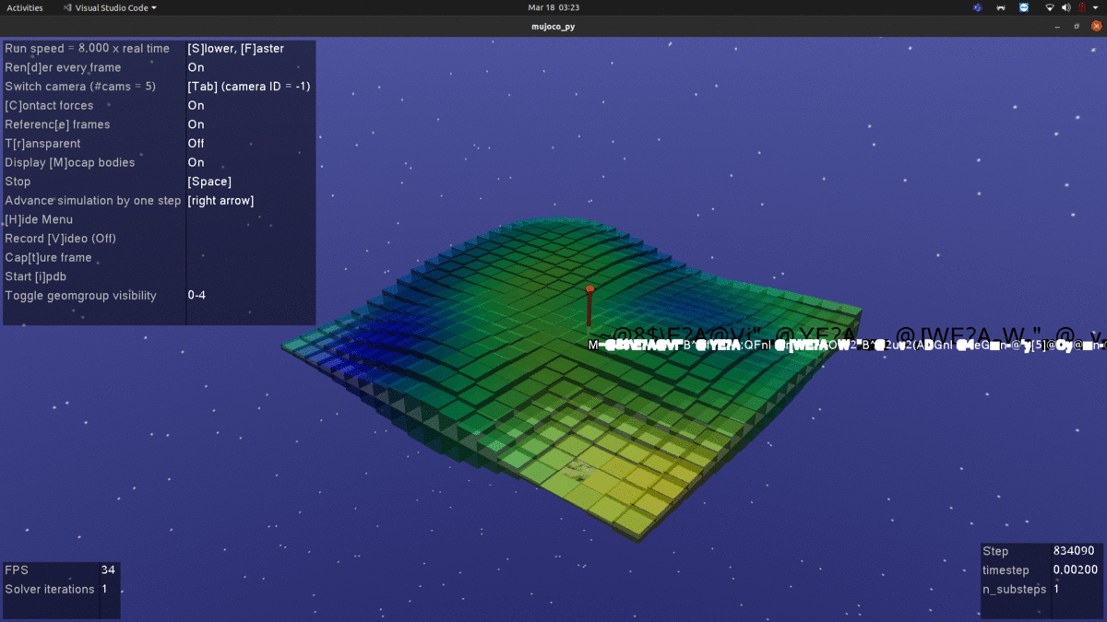
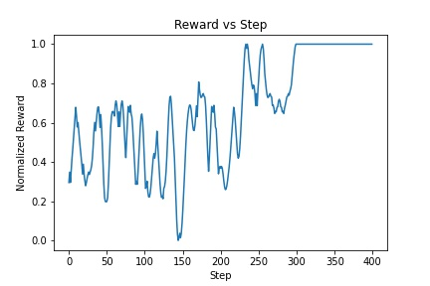
GP-SAFETY-GYM represents the reward by a color (yellow: high; green: medium; blue: low), and the safety by height.
fig 1: Example screen capture from the GP-SAFETY-GYM environment
fig 2: Normalized reward vs No of Steps

Slide 12
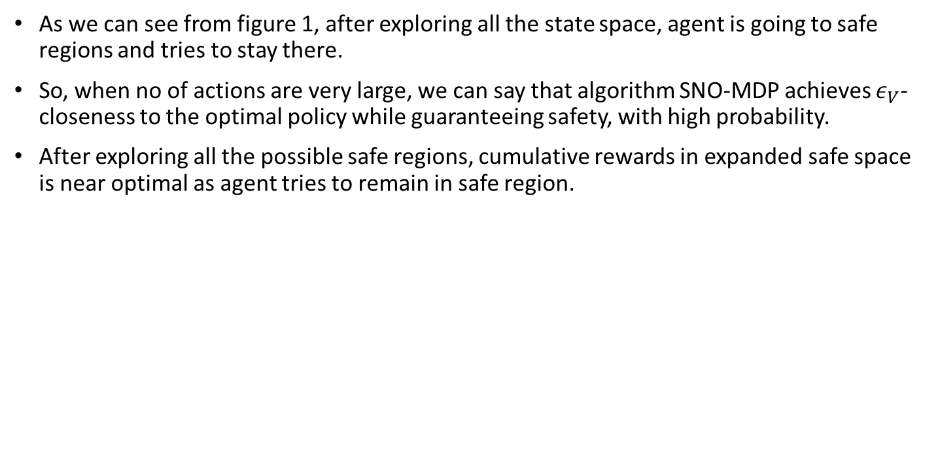
Conclusion
As we can see from figure 1, after exploring all the state space, agent is going to safe regions and tries to stay there.
So, when no of actions are very large, we can say that algorithm SNO-MDP achieves $ε_{V}$-closeness to the optimal policy while guaranteeing safety, with high probability.
After exploring all the possible safe regions, cumulative rewards in expanded safe space is near optimal as agent tries to remain in safe region.

Slide 13
Applications
This technique can be used in medical field like detecting Type 1 Diabetes by constraining the safety condition on the amount of insulin to be injected w/o going into hyperglycemia or hypoglycemia.
This can be used in suggesting ads to particular user.
It can be used to train the robots by exploring the behaviour which might be safe.
This can be used to explore the places which are unknown priori but there is a chance that it might be safe region to work on like extraterrestrial planet or unexplored places in ocean using some drone or robots.

Slide 14
Thank you

Slide 15
Reference
Safe Reinforcement Learning in Constrained Markov Decision Processes by Akifumi Wachi and Yanan Sui.

